Slide 1
CMSI 186
Spring 2020
Prof. Alissa Volosin

Slide 2
01.16.20
Quick Review
Jshell
Hello, world!
Survey
Attendance / Ice Breaker
About the Class / Syllabus
Tools you will use
Assignment 00

Slide 3
Review
Write a program that prints “hi” to the console.
Let’s add some comments!
jshell

Slide 4
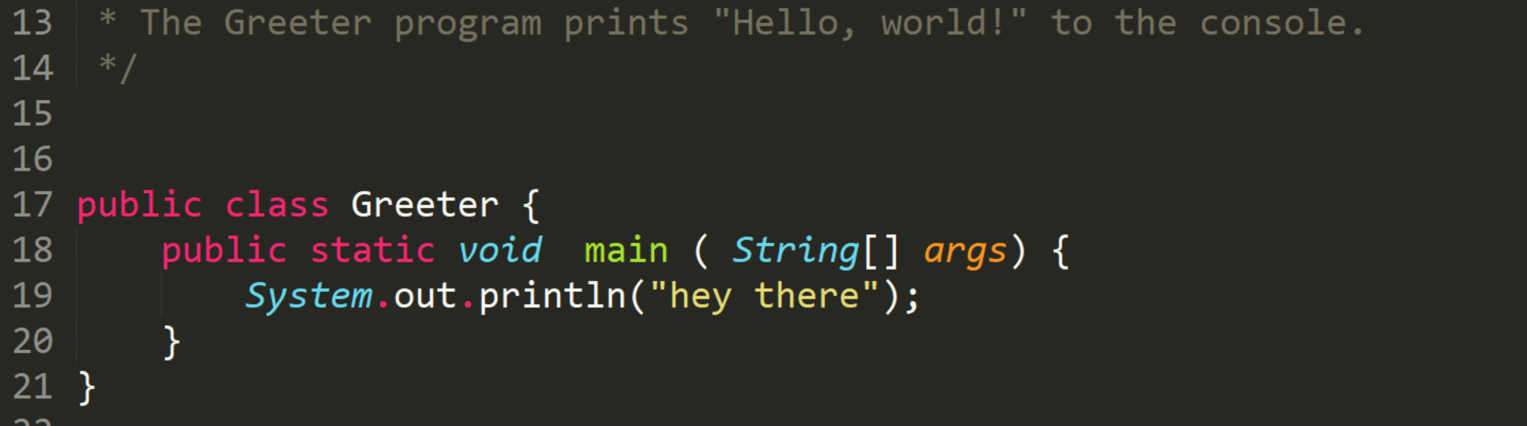
Syntax
What are some examples of syntax in the greeter program?

Slide 5
Class
Classes allow us to make our own type
A class is defined by:
Its variables (fields)
What it can do (methods)

Slide 6

A class for “Dog”
What are some attributes (fields) of dogs?
Name
Age
Gender
Weight
Breed
Color

Slide 7
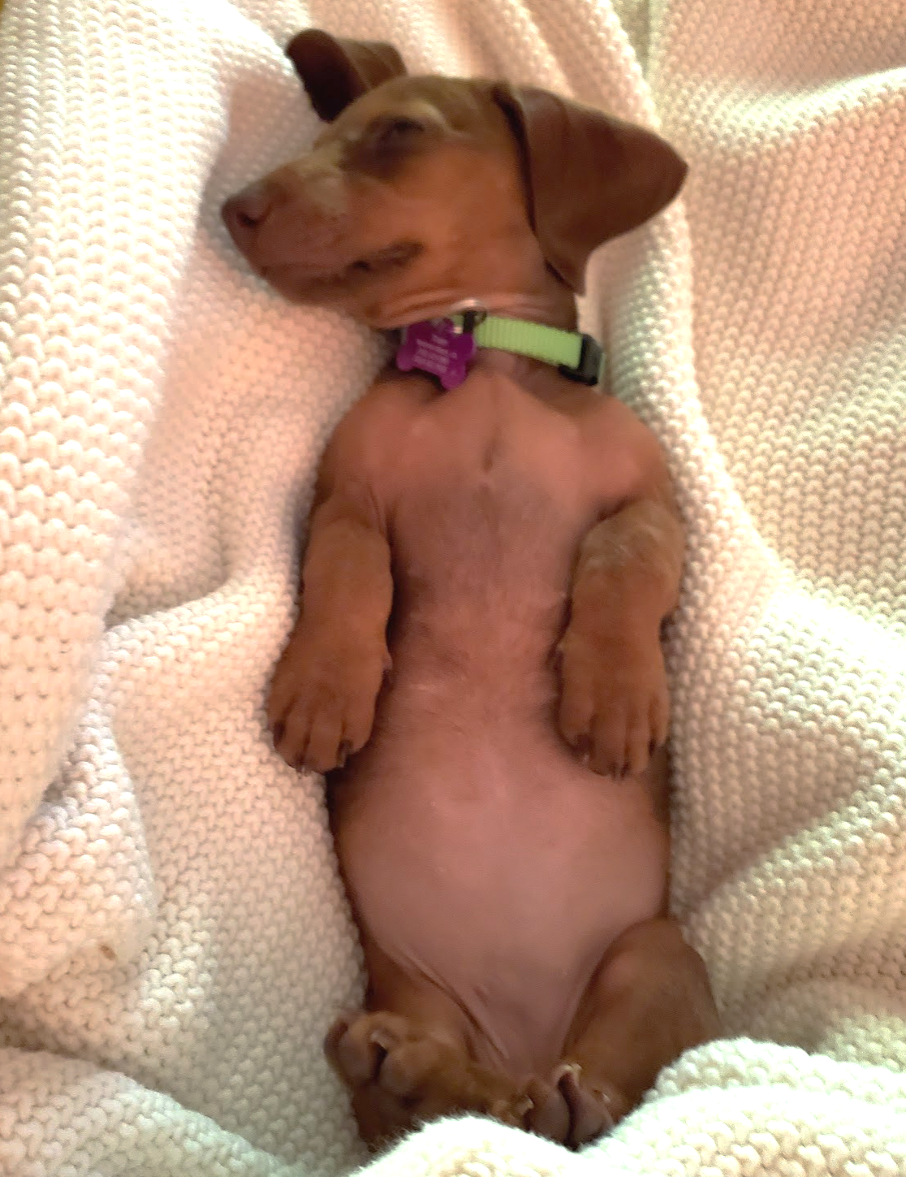
A class for “Dog”
What are some things a dog can do (methods)?
Bark
Eat
Drink
Sleep
Run
Fetch
Lick
Destroy

Slide 8
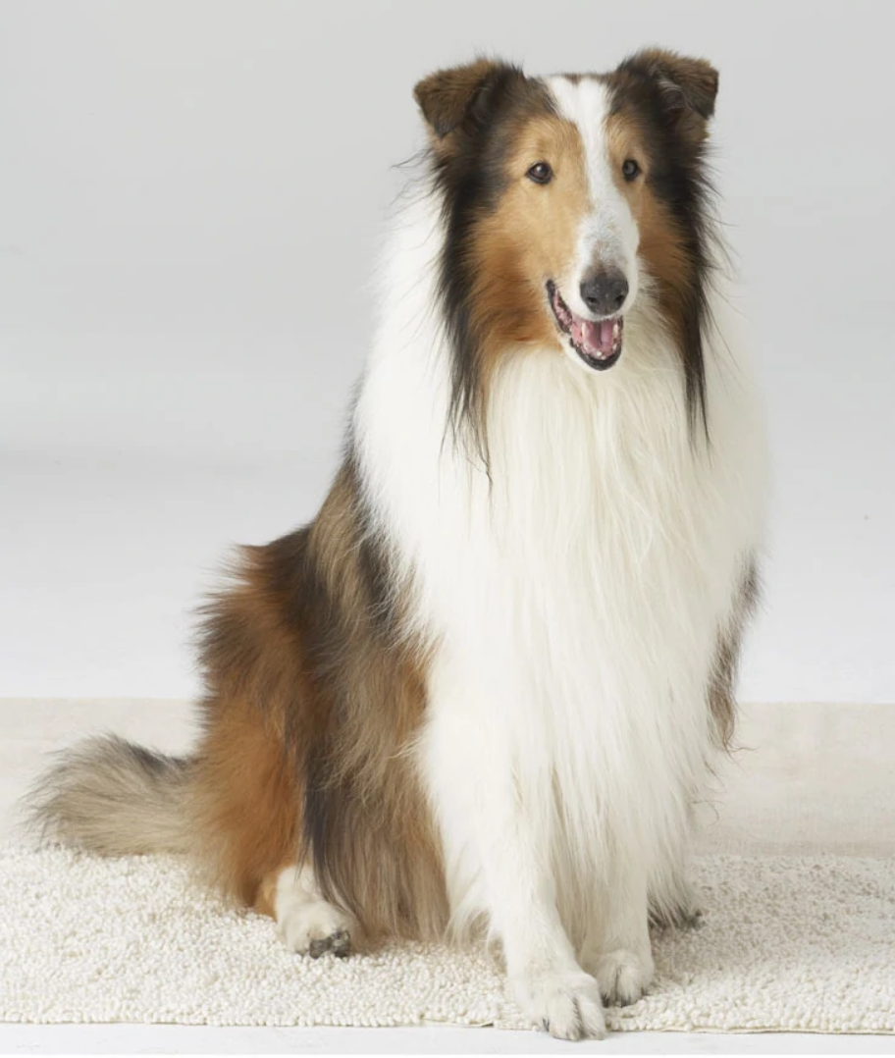
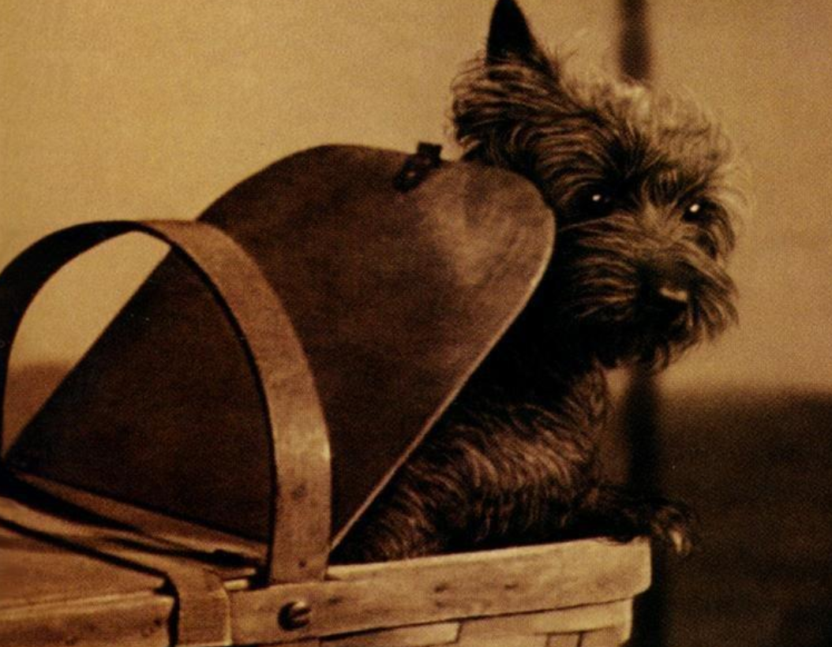

Objects are Instances of a Class
Class
Dog
Object
Object
Object

Slide 9
Command / Terminal Objectives
List the contents of a folder
Navigate to a folder
Create files and folders
Move, copy and remove files and folders
Clone and pull from a GitHub repository
Add, commit and push changes to a repository

Slide 10
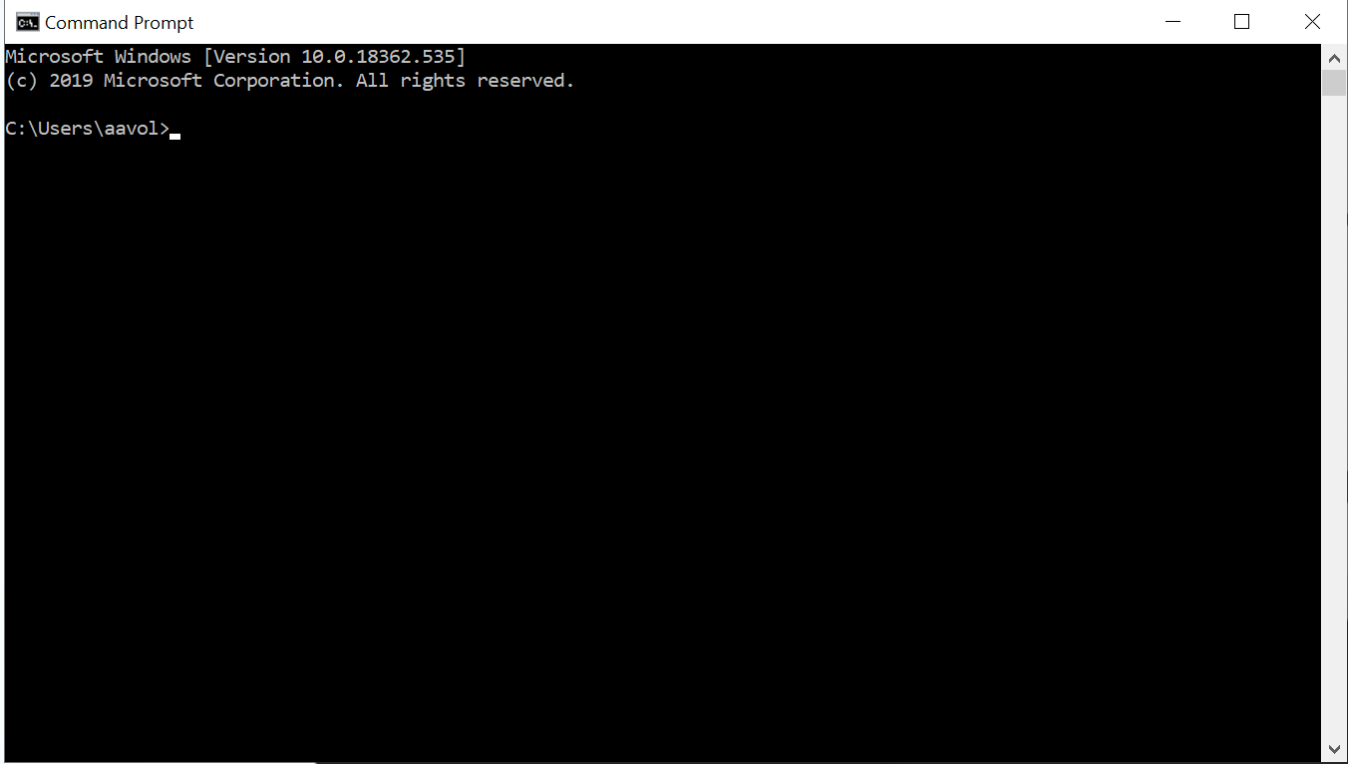
Command Line ( Command Prompt / Terminal )
Faster and more powerful way to interact with the computer than the GUI (graphical user interface)

Slide 11
Opening the Command Line
MAC: Open Spotlight search with Command + spacebar, then type terminal
Windows: Press Windows then type cmd, then press Enter

Slide 12
Listing a Folder’s Contents
ls: list the files in this folder (Mac)
dir: list everything in this folder (PC)
pwd: present working directory (which folder I am in)

Slide 13

Command / Terminal Objectives
List the contents of a folder
Navigate to a folder
Create files and folders
Move, copy and remove files and folders
Clone and pull from a GitHub repository
Add, commit and push changes to a repository

Slide 14
Navigating to a Folder
cd: change directory %cd Documents
Go to a subdirectory of current directory
%cd Documents
Go to a specific directly
%cd C:\Users\aavol\Documents\LMU\CMSI 186\Spring 2020
Go up a level
%cd ..

Slide 15
Tip: Autocomplete with tab
Press the tab key!
%cd doc %cd Documents
What happens if I type “do” and there are many subdirectories that start with “do”?
What happens if I type “do” and there are no folders that start with “do”?

Slide 16
Tip: Up Arrow Shortcut
Type the Up arrow on your keyboard, it will pull up the previously typed command.
What happens if you type the Up arrow twice?

Slide 17
Parent and Child Directories
Home Directory
( C:\Users\aavol )
Desktop
Documents
Downloads
LMU
How do I navigate from my home directory to CMSI 186?
CMSI 185
CMSI 186

Slide 18
File Paths
Option 1:
Option 2:
%cd Documents
%cd LMU
%cd “CMSI 186”
%cd Documents\LMU\“CMSI 186”

Slide 19
Try it out!
Use pwd to see what your current directory is.
Use ls or dir to see what is inside of your current directory.
Move inside of one of the folders in your current directory and us ls or dir to see what is inside of it.

Slide 20
Command / Terminal Objectives
List the contents of a folder
Navigate to a folder
Create files and folders
Move, copy and remove files and folders
Clone and pull from a GitHub repository
Add, commit and push changes to a repository

Slide 21
Make files and directories
Mac
touch: create a new file
%touch test.txt
PC
type nul: create a new empty file
%type nul > test.txt
mkdir: make a new directory
%mkdir my_new_folder

Slide 22
Moving and copying files
Mac
mv: move a file or directory to a new location
%mv test.txt ..
PC
move: move a file or directory to a new location
%move test.txt ..
cp: copy a file to a new location
%cp test.txt ..
copy: copy a file to a new location
%copy test.txt ..
cp -r: copy a folder to a new location (recursively)
%cp -r test_folder ..
copy -r: copy a folder to a new location (recursively)
%copy -4 test_folder ..

Slide 23
Deleting files and directories
Mac
rm: remove a file
%rm test.txt
PC
del: delete a file
%move test.txt ..
rm -r: remove a folder (recursively)
%rm -r test_folder
rmdir /s: remove a folder (recursively)
%rmdir /s test_folder

Slide 24
Try it out!
Create a new file.
Create a new directory.
List the contents of the current directory.
Move the file into a new directory.
Recursively remove the new directory you just created.

Slide 25
Command / Terminal Objectives
List the contents of a folder
Navigate to a folder
Create files and folders
Move, copy and remove files and folders
Clone and pull from a GitHub repository
Add, commit and push changes to a repository

Slide 26
Command / Terminal Objectives
List the contents of a folder
Navigate to a folder
Create files and folders
Move, copy and remove files and folders
Clone and pull from a GitHub repository
Add, commit and push changes to a repository

Slide 27
Git GitHub
Git is a free and open source distributed version control system for programming projects
Strictly a command-line tool
An advanced version of saving documents
Benefits:
Save changes
Revert to previous versions
Save projects to the cloud
View all versions and history
Multiple users
A website that hosts projects code online
Notes:
Print out syllabus
Print out BJ syllabus, read from his

Slide 28
Cloning a repository
Navigate to the directory where you want the code to be saved in your filesystem.
Then run this command:
%git clone [repo_url]

Slide 29
Saving your changes
Go inside your repository. See what files have changed:
%git status
Push your changes using the following commands:
%git add Greeter.java
%git commit
%git add Greeter.java
%git commit -m “adding Greeter”
%git push origin master
OR
i: insert
type your commit comment
wq: write quit to exit commenting
%git push origin master

Slide 30
Pulling new code
To pull code that someone else pushed to the repo:
%git pull

Slide 31
Command / Terminal Objectives
List the contents of a folder
Navigate to a folder
Create files and folders
Move, copy and remove files and folders
Clone and pull from a GitHub repository
Add, commit and push changes to a repository

Slide 32
What is GitHub?
GitHub is a website that hosts git repositories (more on repositories later)
Git and GitHub are separate - you can use git without using GitHub (you can use other sites such as GitLab)
GitHub takes all of the features of git and adds new features:
Web interface
Access control
Wikis
Feature requests
Notes:
Print out syllabus
Print out BJ syllabus, read from his

Slide 33
Important Terms
Terminal/command line: a tool which allows you to type text commands to perform specific tasks instead of using the mouse to point and click on menus/buttons
Repository (repo): where the history of your work is stored
Clone: a copy of a repository (i.e. clone GitHub repository to your local computer)
Fork: your own copy of someone else’s repository, where you would make diverging changes
Branch: essentially a fork of your own repository
Allows you to work on multiple features at once without fear of affecting your working master branch
Commit: each “hard save” of your work; a repository shows the history of all commits
Notes:
Print out syllabus
Print out BJ syllabus, read from his

Slide 34
assignment01 - music-mashup
Get the assignment at - volosin.lmu.build
You will see several folders for music genres. Inside them are artist folders and artist images. But the files are all mixed up!
Your task is to use the command line to organize all of the folders and files.
Don’t worry about efficiency, feel free to explore and try things out!
Notes:
Print out syllabus
Print out BJ syllabus, read from his

Slide 35
Additional Resources
Pro Git: http://git-scm.com/book/en/ v2 Git Immersion: http://gitimmersion.com/
YouTube Git: https://www.youtube.com/user/
GitHubGuides/featured Think Like a Git: http://think-like-agit.net/sections/about-this-site.html
Code School’s Try Git (now Pluralsight): https:// www.codeschool.com/courses/trygit (Basic course is free, further courses require a subscription)
Notes:
Print out syllabus
Print out BJ syllabus, read from his

Slide 36
Get Comfortable with the Command Line
War Games:
http://overthewire.org/wargames/
Notes:
Print out syllabus
Print out BJ syllabus, read from his

